Slide 1
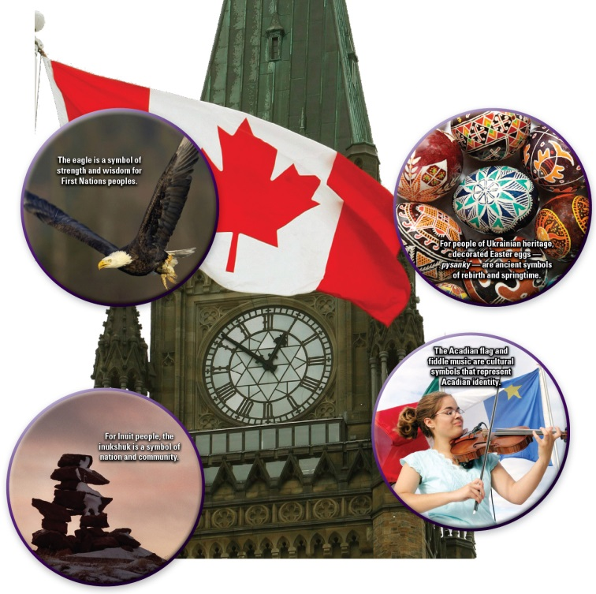
The Quest for Canadian Unity

Slide 2
What is National Unity?
When people feel a sense of national unity, they identify with others who belong to the same nation.
For many Canadians this means respect for diversity.
In civic nations, such as Canada, promoting national unity often involves trying to achieve consensus.

Slide 3
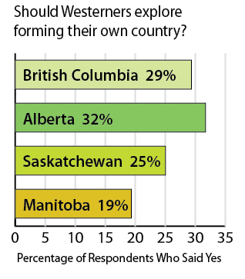
How does the nature of Canada affect national unity?
Keeping a group together can be a challenge.
Finding ways to settle conflicts—and keep the group together—can be difficult.

Slide 4
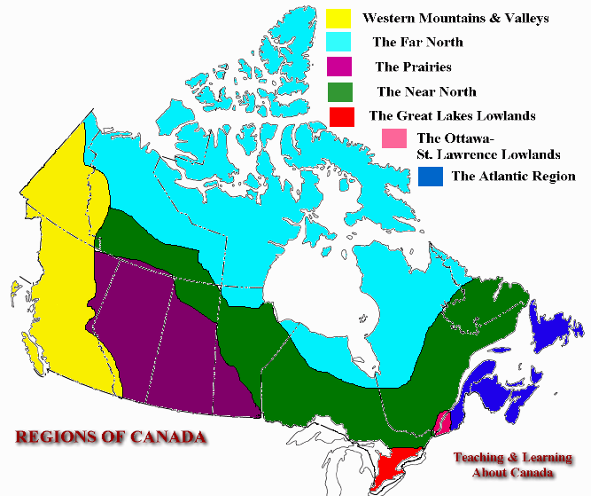
The Geography of Canada
The geography of Canada’s regions is very different.
The needs of people living in the Atlantic Region are very different than those living on the prairies.
These differing needs may create tensions between people of different regions.

Slide 5
Examples:
Alberta has the highest employment rate in Canada.
Many people from the Atlantic provinces have moved west to find jobs.
This migration has left provinces such as Newfoundland without some of their most skilled workers.
In the North, climate change is destroying the habitat of some animals that people harvest for food.
But in Saskatchewan, farmers may benefit from a longer growing season.

Slide 6
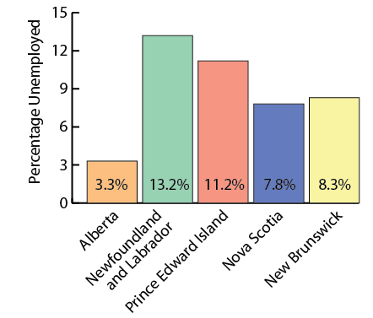
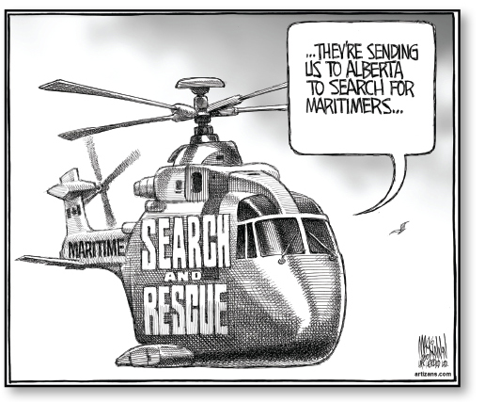

Slide 7


Slide 8
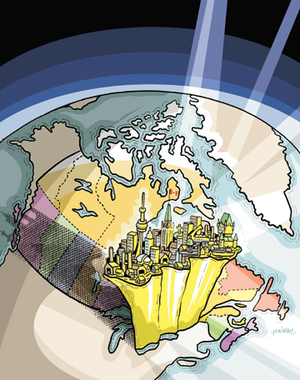
Western Alienation
NEP – National Energy Program – the federal government and Alberta argued over who should control oil development and revenues.
Founding of the Reform Party – “The West wants in” – wanted a greater voice and more control over decisions made in Ottawa.

Slide 9
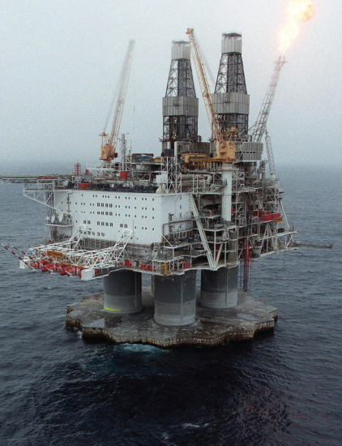
Alienation in Other Regions
Newfoundland and Labrador and the federal government continue to argue over oil royalties. (Hibernia oil field in the Grand Banks)

Slide 10
Equality and Fairness in a Federal System
Ensuring that all citizens feel as if they are treated fairly and equally presents many challenges—and can affect people’s sense of national unity.

Slide 11
Equalization Payments
The federal government must ensure that all Canadians—no matter where they live—have equal access to public services.
Since 1957, the Canadian government has used a system of equalization payments to try to achieve this goal.
Tax revenue is distributed to provinces that are in need.
The provincial governments that receive the payments then decide how to spend the money.
Prosperous provinces often claim that their taxpayers contribute too much to the program.
Less prosperous provinces sometimes say they do not receive enough.

Slide 12
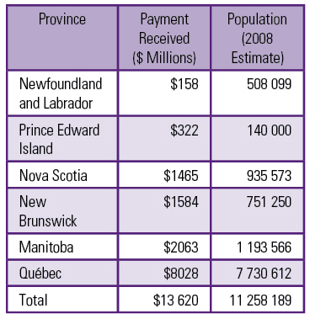
Distribution of Equalization Payments, 2008-2009

Slide 13
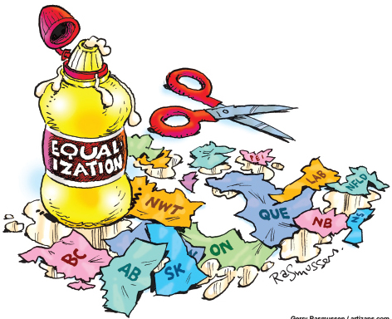
Equalization Payments
Gerry Rasmussen created this cartoon in 2005 as a comment on how equalization payments affect Canadian unity. At the time, federal and provincial leaders were trying to agree on a formula for calculating how much each province should either contribute or receive.

Slide 14
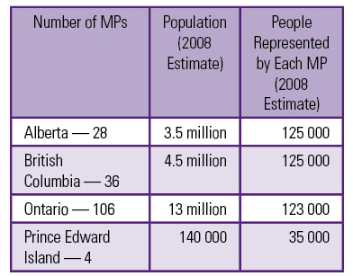
Political Representation
Canada’s population is spread unevenly across the country.
About 2/3 of Canadians live in Ontario and Quebec.
If each Canadian’s vote had equal weight, Parliament would be filled with representatives from Ontario and Quebec.
To resolve this challenge, a compromise was built into the Confederation agreement.

Slide 15
Official Multiculturalism
In 1971 Canada became the first country to adopt multiculturalism as official government policy.
By 2006, an estimated one in every six Canadians was a member of a visible minority group.
All governments need to find ways to balance Canada’s traditions and a vision of the future that Canadians of all heritages could unite behind and promote.

Slide 16
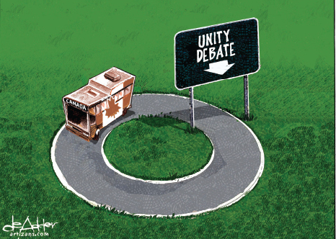
Quebec Sovereignty and National Unity
One of the greatest challenges to Canadian national unity has been the rise of Quebec nationalism.
One of the greatest challenges to Quebec nationalism has been the federal government’s ability to convince Quebecois that Canada is their country.

Slide 17
The Royal Commission on Bilingualism and Biculturalism
FLQ – Front de Liberation du Quebec – started a terrorist campaign by planting bombs in mailboxes.
As a result the federal government set up the B and B Commission
Findings of the commission were:
  Most Francophones were shut out of positions of economic and decision-making power, even in Quebec.
  Francophone minorities outside of Quebec did not have the same educational opportunities as the Anglophone minority in Quebec.
  Many Francophones could not get jobs in the federal government and could not access federal services in French.

Slide 18
Reactions to the B and B Commission
Some people in the west viewed it as a government trick to force them to learn French.
Some Aboriginal people said the focus was too narrow because it did not acknowledge their existence.
The government offered federal funds to encourage provinces to offer more French-language education.
New Brunswick declared itself officially bilingual.
A federal department of multiculturalism was created—and this led to changes in policies toward all minorities.

Slide 19
Official Bilingualism
Pierre Trudeau and the Official Languages Act 1969 – Goals:
  Affirm French and English as official languages of Canada.
  Guarantee that federal services are available in both official languages.
  Ensure that both have equal opportunities to participate in Parliament and other federal institutions.
  *In 2006, 20 % of Canadians said that they speak at least one non-official language at home—intensifying the challenge of promoting official bilingualism.

Slide 20
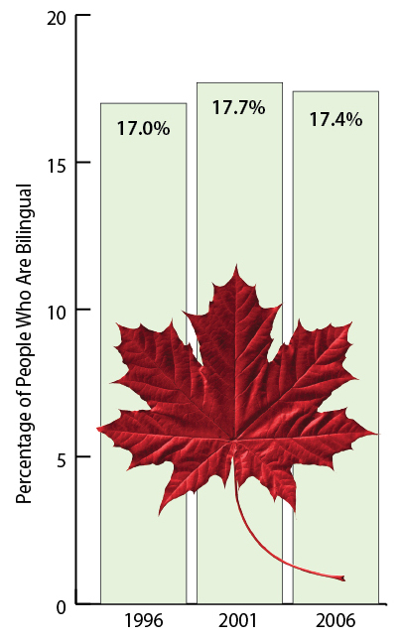
English-French Bilingualism in Canada,
1996-2006

Slide 21
Aboriginal Self-Determination and National Unity
Aboriginal peoples believe that self-determination is an inherent right—a right that exists because they occupied the land and governed themselves for thousands of years before Europeans arrived in North America.
Although Canada’s 1982 Constitution recognized “Aboriginal rights”, it did not way whether those rights included self-determination and self-government.
The Canadian government has refused to support the U.N. Declaration on the Rights of Indigenous Peoples. This declaration affirms Aboriginal Peoples right to self-determination—and to self-government in “matters relating to their internal and local affairs”.

Slide 22
Aboriginal Land Claims and National Unity
In recent decades, few of the hundreds of outstanding Aboriginal land claims have been settled.
Though specific land claims are not always tied to self-government, the two issues often affect each other.

